Slide 1

8th Grade Math: Pre-Algebra
Unit 11, Lesson 2 Constructing Line Graphs Volume 2, pg. 184

Slide 2


Benchmark
MA.8.DP.1.1
Given a set of real-world bivariate numerical data, construct a scatter plot or a line graph as appropriate for the context.
volume 2, pg. 184

Slide 3
Integrated Mathematical Thinking and Reasoning Standards
MA.K12.MTR.1.1 Actively participate in effortful learning both individually and collectively.
MA.K12.MTR.2.1 Demonstrate understanding by representing problems in multiple ways.
MA.K12.MTR.4.1 Engage in discussions that reflect on the mathematical thinking of self and others.
MA.K12.MTR.7.1 Apply mathematics to real-world contexts.
volume 2, pg. 184

Slide 4

Learning Target
I can construct a line graph given a set of real-world data.
volume 2, pg. 184

Slide 5

Warm-Up
volume 2, pg. 184

Slide 6
11.2.1 Warm-Up: Trends
The term trend is used in many contexts.
Describe a current fashion trend.
Describe what it means for something to be “trending” on Netflix or Twitter.
What do you think “trend” means in mathematics in the context of numerical data?
volume 2, pg. 184

Slide 7

Guided Instruction
volume 2, pg. 185

Slide 8
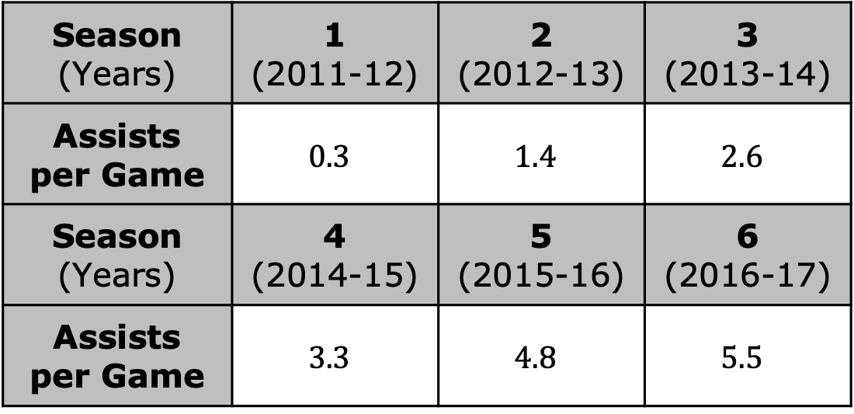
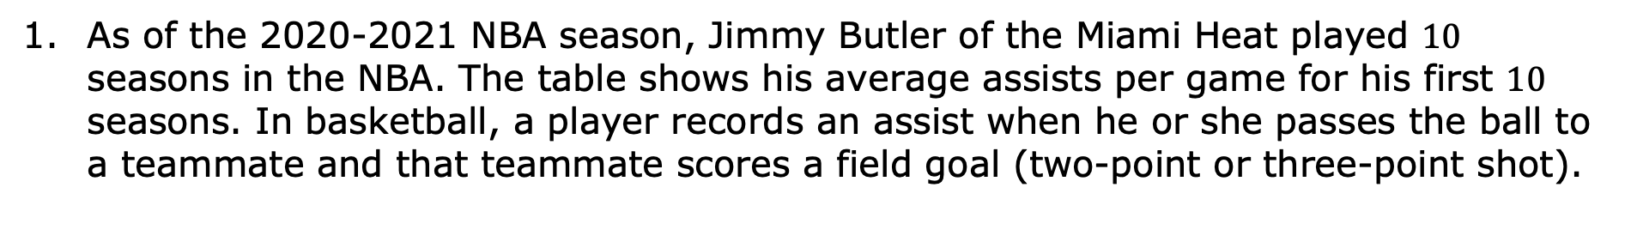
11.2.2 Guided Instruction: Constructing Line Graphs
As of the 2020-2021 NBA season, Jimmy Butler of the Miami Heat played $10$ seasons in the NBA. The table shows his average assists per game for his first $10$ seasons. In basketball, a player records an assist when he or she passes the ball to a teammate and that teammate scores a field goal (two-point or three-point shot).
Season (Years) | 1 (2011-12) | 2 (2012-13) | 3 (2013-14)
Assists per Game | $$0.3$$ | $$1.4$$ | $$2.6$$
Season (Years) | 4 (2014-15) | 5 (2015-16) | 6 (2016-17)
Assists per Game | $$3.3$$ | $$4.8$$ | $$5.5$$
volume 2, pg. 185

Slide 9
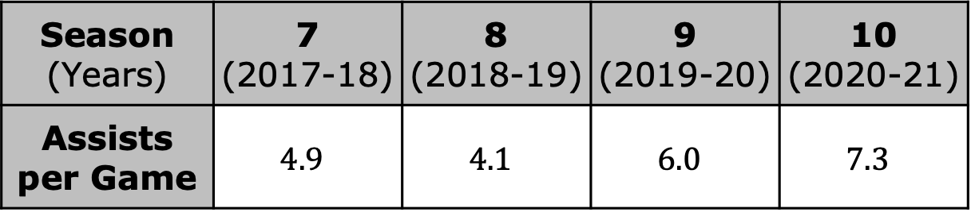
Season (Years) | 7 (2017-18) | 8 (2018-19) | 9 (2019-20) | 10 (2020-21)
Assists per Game | $$4.9$$ | $$4.1$$ | $$6.0$$ | $$7.3$$
Identify the independent and dependent variable in this context.
Independent Variable
Dependent Variable
volume 2, pg. 185

Slide 10
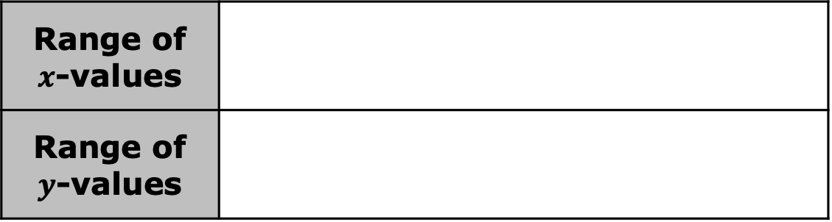
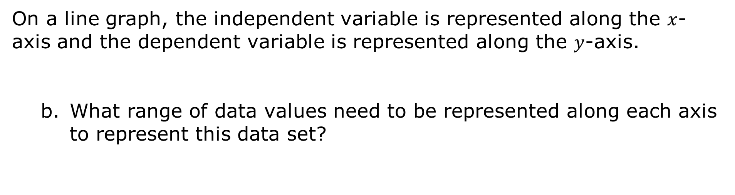
On a line graph, the independent variable is represented along the $x$-axis and the dependent variable is represented along the $y$-axis.
What range of data values need to be represented along each axis to represent this data set?
Range of $x$-values
Range of $y$-values
volume 2, pg. 185

Slide 11
Construct a line graph to represent the data by completing the following.
Label the axes with the appropriate variables.
Identify and label an appropriate scale based on the data for each axis on the grid.
Plot a point for each pair of values in the data set.
Connect the points in order, using a straightedge.
Title the graph.
volume 2, pg. 185

Slide 12

A trend in mathematics describes a change over time. In cases of bivariate data where one of the variables is not time, trends describe how one variable changes in relation to changes in the other.
Describe the trend of the data represented on the line graph.
volume 2, pg. 186

Slide 13
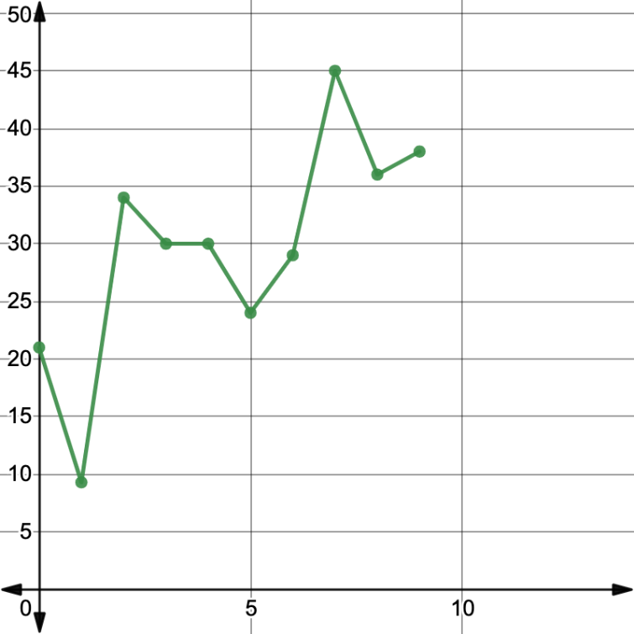
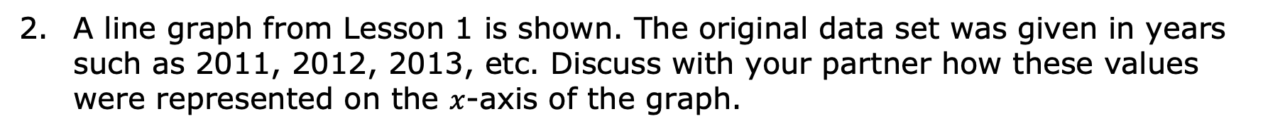
A line graph from Lesson 1 is shown. The original data set was given in years such as 2011, 2012, 2013, etc. Discuss with your partner how these values were represented on the $x$-axis of the graph.
Number of Symptomatic Cases of Flu in the U.S., in millions
Number of Years Since 2011
volume 2, pg. 186

Slide 14

Activity
volume 2, pg. 186

Slide 15

11.2.3 Activity: Gallery Walk
Work with your partner or small group to construct a line graph to represent the data set assigned. Be sure to include the following when constructing your graph.
Label the axes with the appropriate variables.
Identify and label an appropriate scale based on the data for each axis on the grid.
Plot a point for each pair of values in the data set.
Connect the points in order, using a straightedge.
Title the graph.
volume 2, pg. 186

Slide 16

Wrap-Up
volume 2, pg. 187

Slide 17
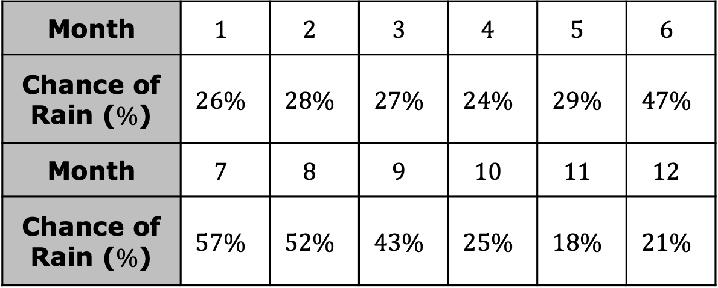
11.2.4 Wrap-Up: Ticket Out the Door
Use the data shown to construct a line graph representing the average monthly chance of precipitation, represented as a percentage ($\%$), in Jacksonville, FL.
Month | $$1$$ | $$2$$ | $$3$$ | $$4$$ | $$5$$ | $$6$$
Chance of Rain ($\%$) | $$26\%$$ | $$28\%$$ | $$27\%$$ | $$24\%$$ | $$29\%$$ | $$47\%$$
Month | $$7$$ | $$8$$ | $$9$$ | $$10$$ | $$11$$ | $$12$$
Chance of Rain ($\%$) | $$57\%$$ | $$52\%$$ | $$43\%$$ | $$25\%$$ | $$18\%$$ | $$21\%$$
volume 2, pg. 187

Slide 18
volume 2, pg. 187

